Slide 1
Identity Management | Data Protection | Authentication Strategies
FIM Workflows with PowerShell
Presented by Craig Martin
October 2013
© 2013 Edgile, Inc. – All Rights Reserved

Slide 2
Edgile Introduction
Established in 2001 by Partners and Senior Managers from Deloitte to Deliver Security Solutions to Leading Companies:
Microsoft Security Solutions from the boardroom to the network
Addressing the most challenging security issues confronting our customers
Long-term relations driving solutions from strategy to deployment
Edgile Exceeds Big-4 in Quality and Style:
Senior resources with real world experience
Small, focused and capable teams
Senior technologist
High
Low
Boutiques
MS
Expertise
VARS
Competitors
Junior Resources,
High % of Clients Not
Reference-able
Big 4
Low
High
Professionalism

Slide 3
Table of Contents
FIM PowerShell Workflows
1
FimPowerShellWF.codeplex.com
2
Installing the Activity
3
The FIM Request Processor
4
Creating Workflow Scripts
5
Debugging Workflow Scripts

Slide 4
FIM PowerShell Workflow Activity
announcing

Slide 5
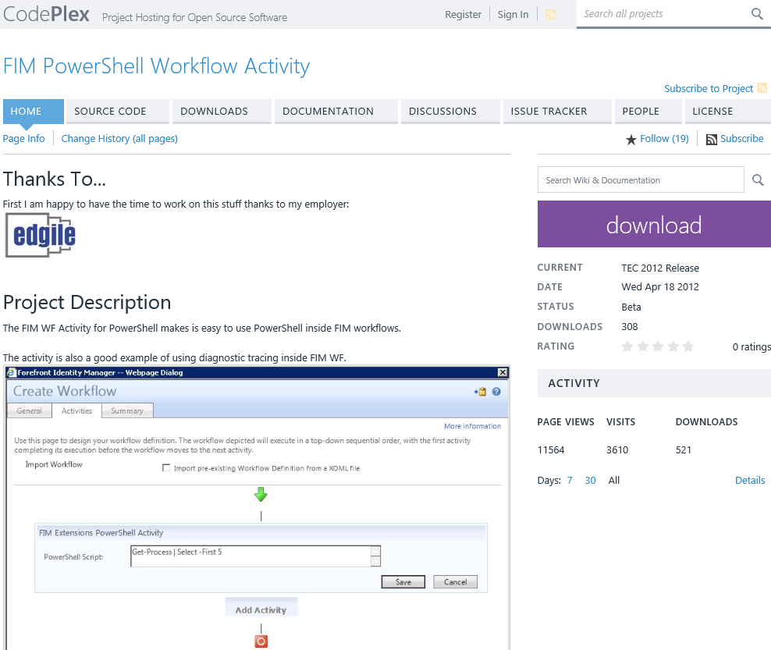
FimPowerShellWF.codeplex.com
Notes:
I use it in production on some very large deployments

Slide 6
Installing the Activity
Add the DLL to the GAC
Update the FIM Service configuration file
Create a FIM Person object for the FIM Service service account
[Optional] Enable Tracing
[Optional] Create a Windows EventLog Source

Slide 7
Installing the Activity
### ### Add the FIM snap-in and the super-awesome FIM PowerShell Module ### Add-PSSnapin fimautomation Import-Module .\FimPowerShellModule.psm1 ### ### Install the FIM PowerShell WF Activity ### .\Install-FimPowerShellWF.ps1 .\Update-FimServiceConfigFile.ps1 .\Create-FimServiceAccountAsFimPerson.ps1

Slide 8
FIM Service Pipeline
Every request to the FIM Services passes through the request pipeline
Workflows can be triggered via policy at each step
New
Request
Permissions
Validation
Authentication
Authorization
Action
(Response)
Access control policies applied
Defined in management policy rules
User identity validation
Self-service password reset
One-time pass code integration
Manager approval
Data input validation
Last chance to reject a request
Successful request response workflow
Most common extensibility point

Slide 9
Why PowerShell Workflow Scripts?
Once you get PowerShell, these are very quick to produce
Easy to develop, test and debug
Good Instrumentation

Slide 10
Why –not PowerShell Workflow Scripts?
Your team already has WF/C# skills
You need the FIM building block activities
Performance penalty of a PowerShell WF is not acceptable

Slide 11
What can you do from that script?
Pretty much anything PowerShell will let you do (limited mostly by your imagination)
Integrate with Active Directory
Integrate with O365
Integrate with the FIM Service
For example, using the FIM PowerShell Module

Slide 12
What can’t you do from that script?
Authentication Activities
Collateral FIM Requests
FIM Impersonation
Custom Approvals
*Use .NET Framework 4.0 and above
*Use PowerShell V3+ modules
*workaround is to use WinRM

Slide 13
AuthZ WF Sample
throw "Solve My Riddle!"

Slide 14
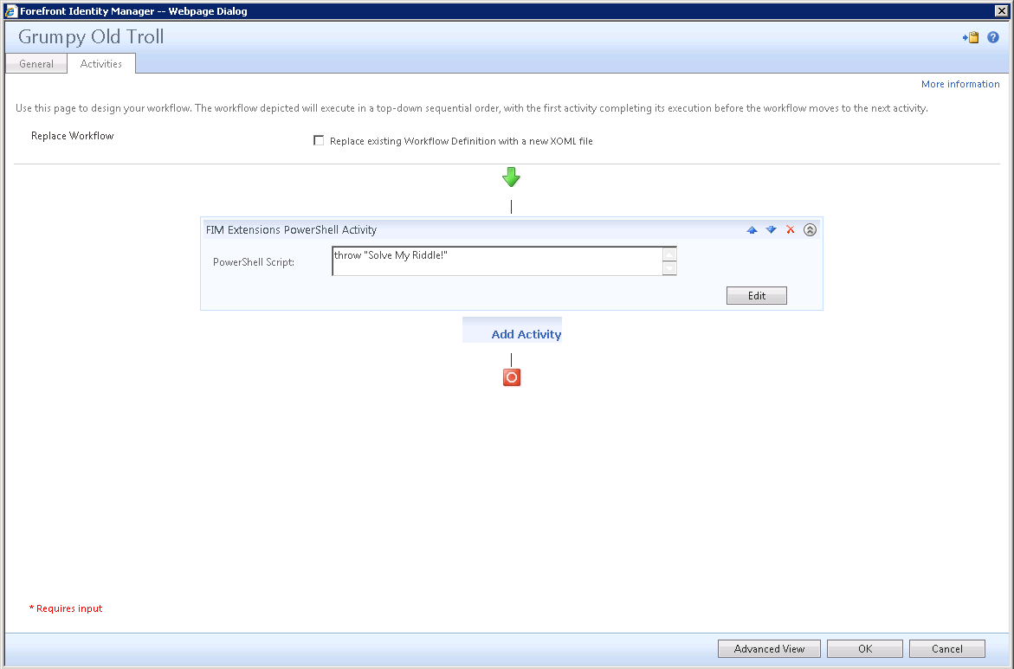
Viewing the Workflow in FIM

Slide 15
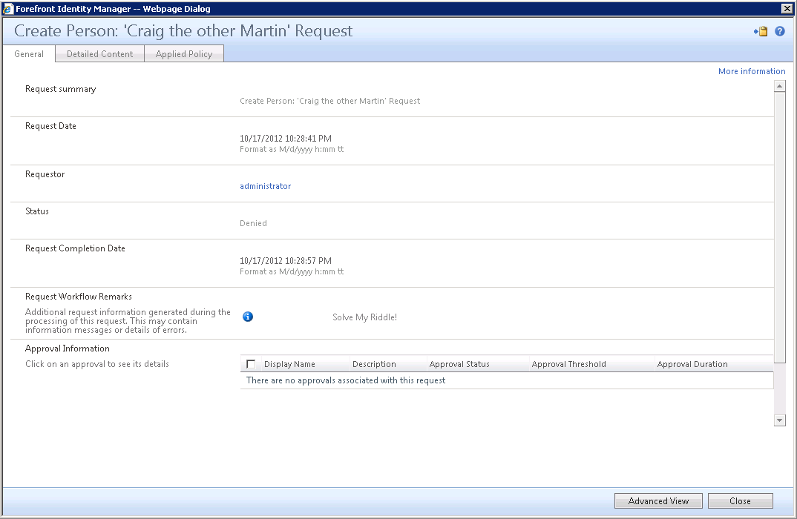
View a FIM Request that hit AuthZ

Slide 16
AuthZ Workflows
DEMO

Slide 17
Anatomy of a FIM Request
Property | Description
$fimwf.RequestID | The GUID of the Request object in FIM
$fimwf.TargetID | The GUID of the FIM object being acted on
$fimwf.ActorID | The GUID of the FIM object that submitted the Request
$fimwf.WorkflowDefinitionID | The GUID of the Workflow being executed
$fimwf.WorkflowDictionary | The dictionary of items for the current Request phase

Slide 18
Reading FIM Request Details
MyPowerShellWorkflow.PS1
### Get the GUID of the Request object in FIM $fimwf.RequestID ### Get the GUID of the FIM object being acted on $fimwf.TargetID ### Get the GUID of the FIM object that submitted the Request $fimwf.ActorID ### Get the GUID of the Workflow being executed $fimwf.WorkflowDefinitionID ### Get the dictionary of items for the current Request phase $fimwf.WorkflowDictionary

Slide 19
Getting Objects from FIM
MyPowerShellWorkflow.PS1
### ### Load the FIM PowerShell Module ### Write-Verbose "Loading the FIM PowerShell Module" Import-Module C:\CodePlex\FimPowerShellModule\FimPowerShellModule.psm1 ### ### Get the Request ### Write-Verbose ("Getting the Request by ObjectID: {0}" -F $fimwf.RequestId.Guid) $Request = Export-FimConfig -Custom ("/*[ObjectID='{0}']" -F $fimwf.RequestId.Guid)| Convert-FimExportToPSObject

Slide 20
Getting Request Parameters
MyPowerShellWorkflow.PS1
### ### Load the FIM PowerShell Module ### Write-Verbose "Loading the FIM PowerShell Module" Import-Module C:\CodePlex\FimPowerShellModule\FimPowerShellModule.psm1 ### ### Get the Request ### Write-Verbose ("Getting the Request by ObjectID: {0}" -F $fimwf.RequestId.Guid) $Request = Export-FimConfig -Custom ("/*[ObjectID='{0}']" -F $fimwf.RequestId.Guid)| Convert-FimExportToPSObject ### ### Get the Request Parameters ### $Request | Get-FimRequestParameter

Slide 21
Viewing PowerShell Trace Output
DEMO

Slide 22
Debugging a Workflow Script
MyPowerShellWorkflow.PS1
### ### Load the FIM PowerShell Module ### Write-Verbose "Loading the FIM PowerShell Module" Import-Module C:\CodePlex\FimPowerShellModule\FimPowerShellModule.psm1 <# ### Mock objects for testing $RequestId = New-Object PSObject -Property @{Guid='00000000-0000-0000-0000-000000000000'} $TargetId = New-Object PSObject -Property @{Guid='00000000-0000-0000-0000-000000000000'} $ActorId = New-Object PSObject -Property @{Guid='00000000-0000-0000-0000-000000000000'} $WorkflowDefinitionId = New-Object PSObject -Property @{Guid='00000000-0000-0000-0000-000000000000'} $fimwf = New-Object PSObject -Property @{ TargetId = $TargetId RequestID = $RequestId ActorId = $ActorId WorkflowDefinitionId = $WorkflowDefinitionId } #>

Slide 23
Debugging a Workflow Script (Sneaking Code Into Comments)
MyPowerShellWorkflow.PS1
### ### Load the FIM PowerShell Module ### Write-Verbose "Loading the FIM PowerShell Module" Import-Module C:\CodePlex\FimPowerShellModule\FimPowerShellModule.psm1 <# ### Mock objects for testing $RequestId = New-Object PSObject -Property @{Guid='00000000-0000-0000-0000-000000000000'} $TargetId = New-Object PSObject -Property @{Guid='00000000-0000-0000-0000-000000000000'} $ActorId = New-Object PSObject -Property @{Guid='00000000-0000-0000-0000-000000000000'} $WorkflowDefinitionId = New-Object PSObject -Property @{Guid='00000000-0000-0000-0000-000000000000'} $fimwf = New-Object PSObject -Property @{ TargetId = $TargetId RequestID = $RequestId ActorId = $ActorId WorkflowDefinitionId = $WorkflowDefinitionId } #>

Slide 24
Debugging a Workflow Script
DEMO

Slide 25
PowerShell WF Activity Roadmap
Implementation of script retry and delay
ETW tracing
Event log integration
Better AuthZ model

