Slide 1
Microsoft Identity Manager 2016 Handbook
David Steadman & Jeff Ingalls
http://aka.ms/mim2016book

Slide 2


David “Steady” Steadman
Jeff “jingalls” Ingalls
Was MSFT FIM PFE (EAST Region)
Now SR Escalation Engineer for FIM/MIM
Microsoft Corporation
Was MSFT FIM PFE (West Region)
Now Identity Architect (FIM/MIM)
IngallsDesigns.com

Slide 3

Our Book Writing Experience
“Do you want to write a book?”
Sent publisher an outline
  Audience, mission, book objectives, structure
  Chapter outline with description, topic level (basic, medium, advanced)
  Chapter skills learned
Contract negotiation, milestones, and deadlines set

Slide 4
Get to Work!
Only a few weeks before first chapter is due
…and we quickly realized we needed to know the end before we can write a beginning
…and the MIM product still in BETA
…and we don’t have a lab environment

Slide 5
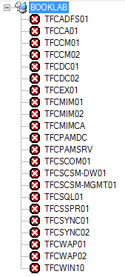
The Lab
2 Dell R610
2 Custom Servers
Total RAM 200 GIG
Total Storage 16TB / Raid 10
22 VMs

Slide 6
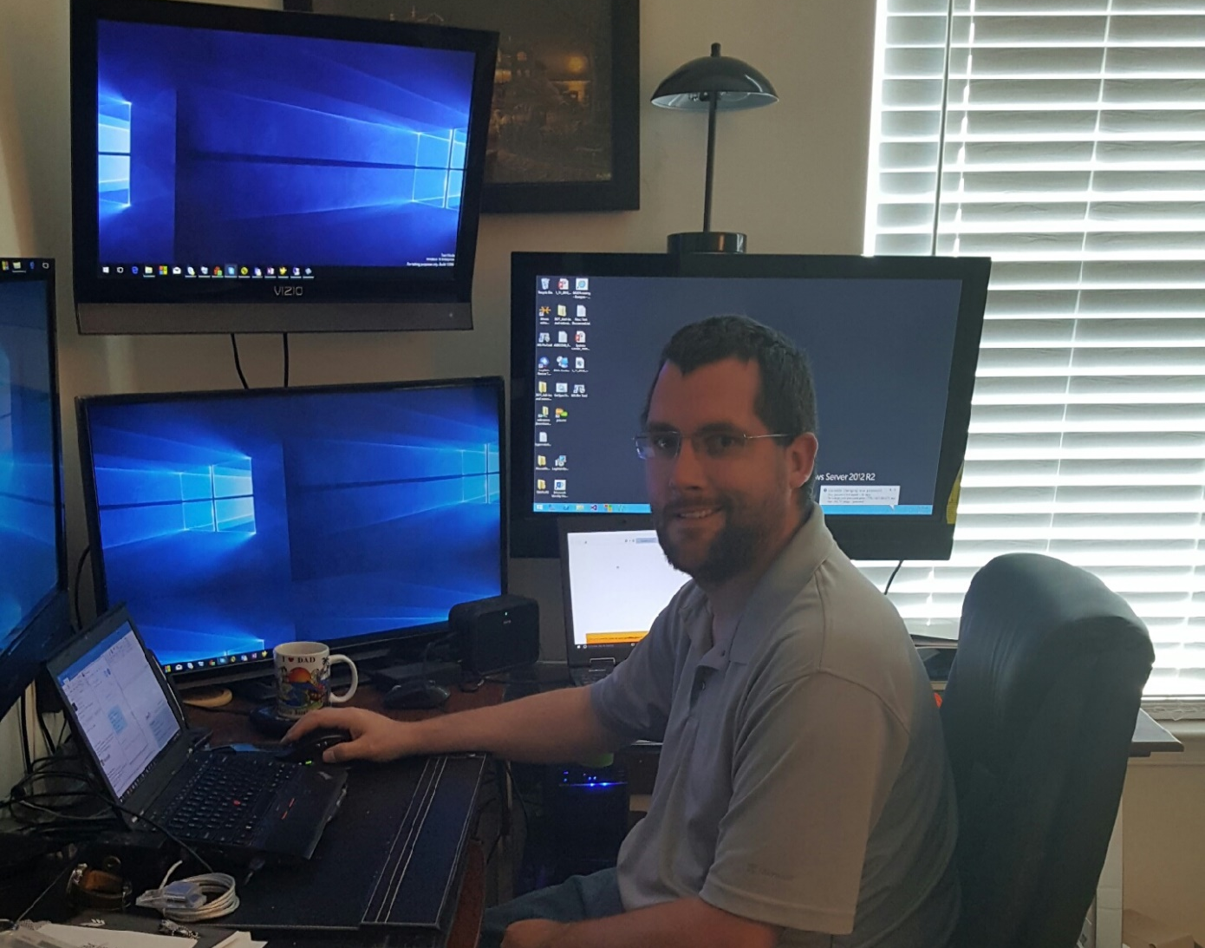

The Grind: Fit Book Writing into Life

Slide 7
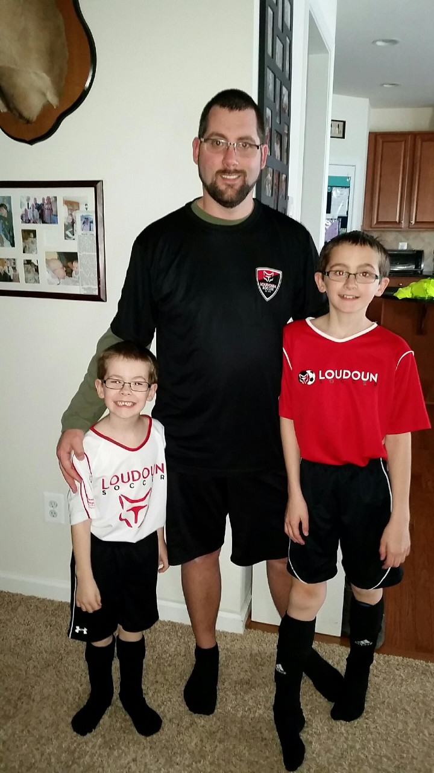
Life
3 Kids
Soccer Coach 2 teams
Work / Cases
Hardware failures
Pre-release MIM bugs
Lab Issues / Fun

Slide 8
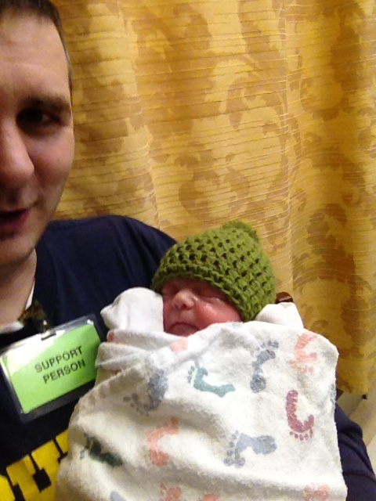
Life
2 kids under 4
Volunteer and charity work
1 baby born, 2 family deaths
Work projects
Graduate school
Power outages & laptop failure

Slide 9
Lessons Learned
Book will be slightly different than initial outline. Chapters may get consolidated or split into more chapters
Expect set backs and a few bugs in a pre-release…sometimes in post-release ;-)
Schedule in writing time; Plan spending days working on the book without writing a word
Acknowledge some days there will be problems or obligations that prevent writing
Decide your scope early

Slide 10
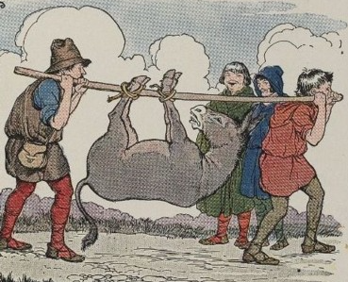
Writing for the Masses
Everyone has an opinion and you will never be able to satisfy everyone.

Slide 11
Get to the Book Already!
1 Overview - 12 pgs
2 Installation - 65 pgs
3 Sync Configuration - 40 pgs
4 Service Configuration - 64 pgs
5 User Management - 79 pgs
6 Group Management - 34 pgs
7 RBAC w/ BHOLD - 70 pgs
8 PAM & MFA - 64 pgs
9 Password Management - 48 pgs
10 Overview of CM - 21 pgs
11 Installation and Client-side of CM - 35 pgs
12 CM Scenarios - 71 pgs
13 Reporting - 26 pgs
14 Troubleshooting - 26 pgs
15 Operations & Best Practices - 10 pgs

Slide 12

What About Discounts and Free Copies?
Sorry…
We don’t control the book price, coupons, freebees or discounts
Almost all our pay is based on you buying the book

Slide 13

David CM
Packt Publishing asked 100+ page CM chapter be split into 3 chapters
David created new open source CMMonitor tool
  Created because of support cases
  http://aka.ms/cmmonitor
  The CMMonitor is a service to monitor Agent accounts in MIM and FIM 2010 R2 and features automated configuration based on Certificate Management Web Configuration, conditional polling on time to check cert, SMTP alerting on expiring certs, event log alerting and logging

Slide 14
Microsoft Identity Manager 2016 CTP aadmimfeedback@microsoft.com
Customer Reported Bug Fixes
JIT groups for Priv domain
PAM PowerShell Deployment
Cross Browser Support
Group Management
Email requests and approvals
with Exchange Online
Updated Platform Support
PAM Single forest deployment
Hardened Security

Slide 15
Questions Before We Look at CMMonitor?

