Slide 1
Using a 2nd MIM as data generator for referential objects
Peter Stapf
MVP - Directory Services
14. October 2015

Slide 2
About me
Age: 44
Location: Germany
MVP (Directory Services)
Senior Consultant @
Main focus: IDM, AD, Azure
Working on IDM since 2006
Blog: http://justIDM.wordpress.com

Slide 3
Environment
DEV
x.domain.com
UAT
t.domain.com
PROD
domain.com
int.x.domain.com
int.t.domain.com
int.domain.com
sbx.domain.com
SBX
FIM 2010 R2 DEV
FIM 2010 R2 UAT
FIM 2010 R2 Production
ext.x.domain.com
EXT DEV
ext.t.domain.com
EXT UAT
ext.domain.com
EXT Prod

Slide 4
Environmental facts
Internal Forests
1200 Users
2500 Groups
3000 Contacts
Admin accounts in each domain
Additional personalized accounts
External Forests
80000 Users
5 major roles/groups
Users grow 250/week
Admin accounts in each domain
Additional personalized accounts
Historical facts
Implemented in 2004 with MIIS
Currently 25 Management Agents
Migrated to ILM, FIM, FIM R2, (MIM)
Re-use DB all the time
Portal for Admin, Helpdesk, Team management

Slide 5
Requirements
Collect and import additional account from all forests/domains
Reference additional accounts to employees
Display account status and permissions
Reporting for IT/Security management
Identify accounts without referenced users
Improper created accounts (EmployeeID for reference)
Accounts of deactivated employees
Account of employees that has left company
Accounts not currently referenced to employees

Slide 6
Challenge

Slide 7
Challenges & Options
Challenges
The 3 stage environment itself
Reference cross forest/domain resources
Access rights, permissions and firewall rules
Options
Connect each forest to each FIM
PowerShell Scripts/Connector to import data from all forests/domain
Separate MIM Sync to collect data from all forests/domain

Slide 8
Solution
Multivalue Groupmember
Multivalue (String)
Account <> Group
7x PS MA Group Memberships
Combined
Multivalue
SQL: Union
Regular IDM FIM
Dev, UAT & Prod
Account Data
Multivalue (Ref) User <> Account
MIM Sync
7x AD MA Additional Accounts
Employees & Accounts
SQL: Union
1x SQL MA HR Employee Data
Employee Data

Slide 9
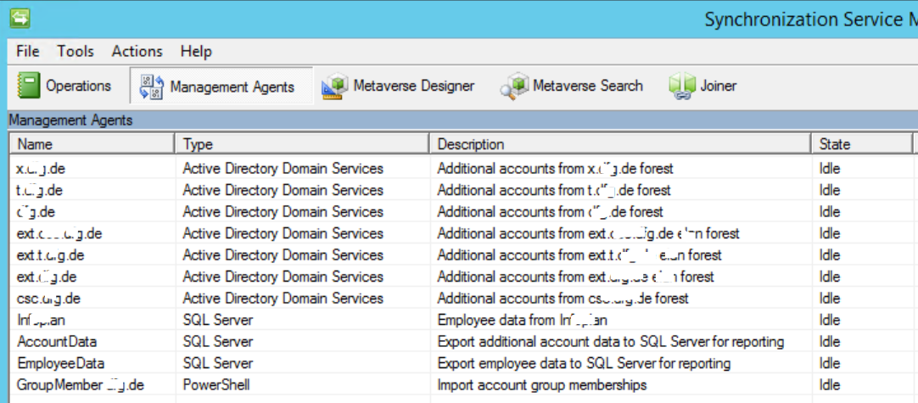
Solution

Slide 10
Tables, Views, SQL
Table: EmployeeData
Table: AccountData
SELECT ID, ObjectClass, Firstname, Lastname, AccountName, EmployeeStatus, NULL AS samAccountName, NULL AS UPN, NULL AS Domain, NULL AS Description, NULL AS EmployeeNumber, NULL AS pwdLastSet, NULL
AS pwdNeverExpires, NULL AS lastLogon, NULL AS accountEnabled
FROM EmployeeData
UNION
SELECT ID, ObjectClass, NULL AS FirstName, NULL LastName, NULL AS Accountname, NULL AS EmployeeStatus, samAccountName, UPN, Domain, Description, EmployeeNumber, pwdLastSet, pwdNeverExpires,
lastLogon, accountEnabled
FROM AccountData
View: IDMAccountView

Slide 11
Tables, Views, SQL
Table: AccountData
Table: AccountDataMultivalue
SELECT EmployeeNumber AS ID, AttributeName, UPN AS AttributeValue
FROM dbo.AccountData
WHERE (EmployeeNumber IS NOT NULL)
SELECT dbo.AccountData.UPN AS ID, dbo.AccountDataMultivalue.AttributeName, dbo.AccountDataMultivalue.AttributeValue
FROM dbo.AccountData INNER JOIN
dbo.AccountDataMultivalue ON dbo.AccountData.Anchor = dbo.AccountDataMultivalue.Anchor
View: IDMGroupMemberMultivalue
View: IDMAdditionalAccountMultivalue
View: IDMAccountMultivalue

Slide 12
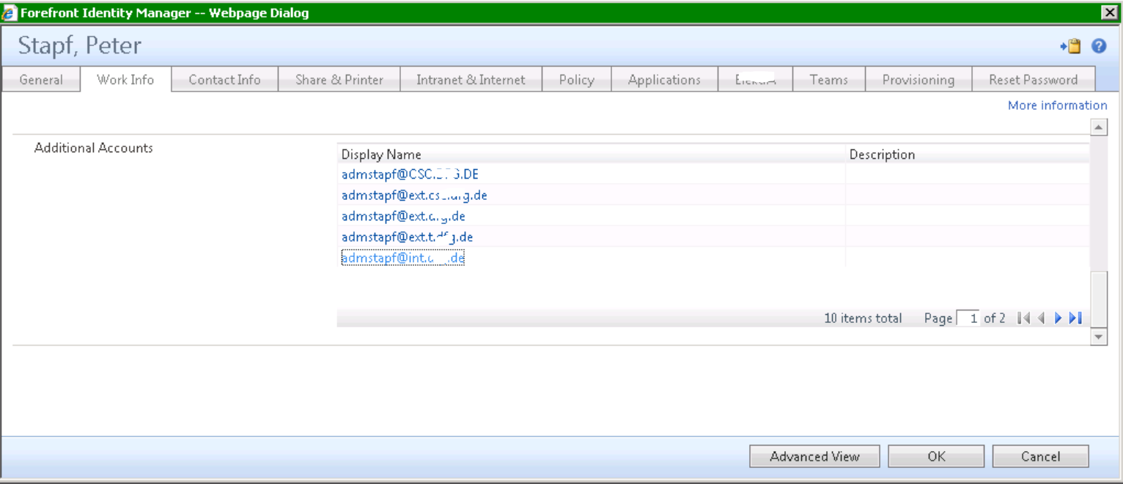
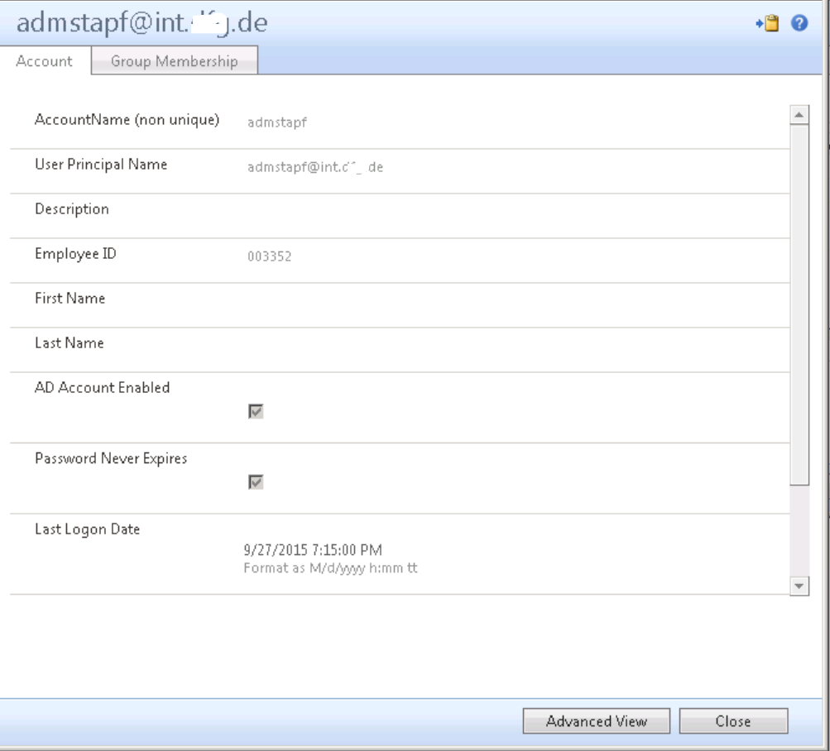
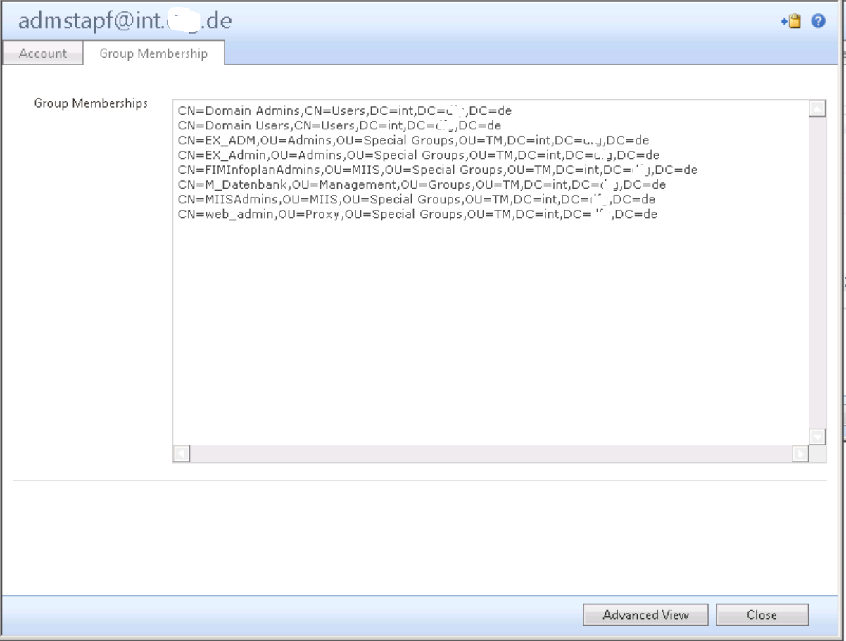
Portal

