Slide 1
Lithnet PowerShell Module for FIM/MIM Synchronization service
http://github.com
/lithnet/miis-powershell

Slide 2
CMDLETS
Clear-RunHistory
Start-ManagementAgent
Stop-ManagementAgent
Wait-ManagementAgent
Set-MVProvisioningRulesExtension
Get-RunProfiles
Get-RunProfileNames
Get-MAStatistics
Get-Connectors
Get-Disconnectors
Get-CSObject
Get-PendingImportUpdates
Get-PendingImportDeletes
Get-PendingImportAdds
Get-PendingExportUpdates
Get-PendingExports
Get-PendingExportRenames
Get-PendingExportDeletes
Get-PendingExportAdds
Get-MVSchema
Get-MVObject
Get-MVConfiguration
Get-ManagementAgent
Get-LastRunDetails
Export-MetaverseConfiguration
Export-ManagementAgent
Set-DisconnectorState
Sync-CSObject
Join-CSObject
Disconnect-CSObject
Project-CSObject

Slide 3
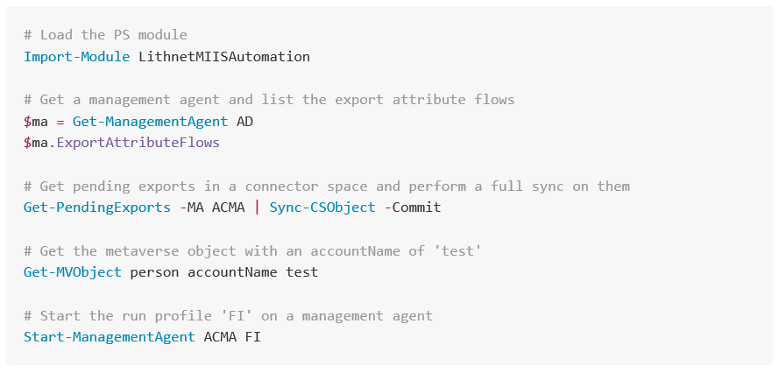
CMDLETS

Slide 4
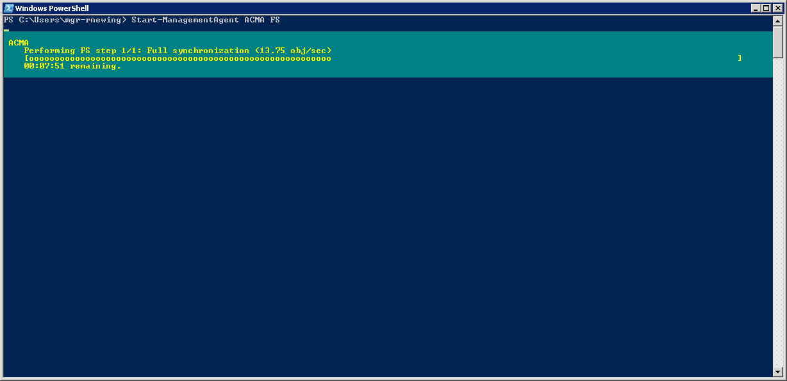
PROGRESS BARS!!

Slide 5
Lithnet PowerShell Module for FIM/MIM Synchronization service
http://github.com
/lithnet/miis-powershell
More coming soon…
Stay up to date:
@RyanLNewington
blog.lithiumblue.com

