Slide 1
FIM User Group BHOLD
Eihab Isaac (FIM MVP)

Slide 2
About Me
FIM MVP
IAM Consultant at Zeva Incorporated
Masters in Information System from George Mason University

Slide 3
BHOLD History
Microsoft acquired BHOLD in September 2011
BHOLD is an Role Based Access Control (RBAC) solution
BHOLD is an extension to FIM

Slide 4
BHOLD Implementation Purposes
Automation
Self-Service
Managing Access Rights
Auditing

Slide 5
Is BHOLD widely implemented?
Is BHOLD widely adopted?
Is it hard to implement and maintain?
Does the problem/s it addresses can be implemented in an alternative easier way?
Is it worth the effort of implementing it?
Should we recommended it to our clients?

Slide 6
BHOLD High-level Design & Integration
AD
HR
BHOLD Attestation
MA
MA
BHOLD Analytics
FIM
Sync DB
FIM Synchronization
B1
database
Access Management MA
BHOLD Reporting
FIM
Service DB
FIM Service
BHOLD Integration
BHOLD Core
BHOLD Model Generator
FIM Portal

Slide 7
BHOLD planning
BHOLD provides 7 components
BHOLD Core
BHOLD Access Management
BHOLD Reporting
BHOLD Attestation
BHOLD Analytics
BHOLD Integration
BHOLD Model Generator
More features
More points of failure
More maintenance
Notes:
Does the features it add have value? What are the paybacks compared to the effort putting it all together?

Slide 8
Implementation Steps
Determine systems to integrate with
Create BHOLD MA
Create OUs in BHOLD
Create users in BHOLD
Create permissions in BHOLD
Set up your role model
Set up your request approvals
Configure reports
Configure attestation campaigns
Install the components

Slide 9
Integration with other Systems/Applications
Needs to conduct sessions with application owners and stakeholders
Integrates with Active Directory and other directories that support groups
Doesn’t provide other means of access provisioning/revoking (Only group membership)
Update an attribute
Provision to a directory
Others
Notes:
Needs to configure an RBAC system that integrate and adds value to the automation process

Slide 10
Installing Components
Fairly straightforward
Challenges with the BHOLD Integration Component
Separate installers. Would be nice to see them integrated more with FIM
Hotfixes require uninstalling and reinstalling the new files

Slide 11
Account
Root
OU1
OU2
OU6
OU3
OU4
OU5
User3 can get/request Role1
Role1
Role2
Role3
Permission1
Permission2
Permission3
App1
App2

Slide 12
Schema Extension
You can’t create additional object types
You can create attributes and bind them to existing objects

Slide 13
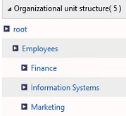
Organizational Units (OUs) & Users
A hierarchal concept to define your structure
Users need to belong to one or more OU
OUs has types
Default is root
Create your own
Define OUs supervisor roles
Define OUs approvers (Line Managers)

Slide 14
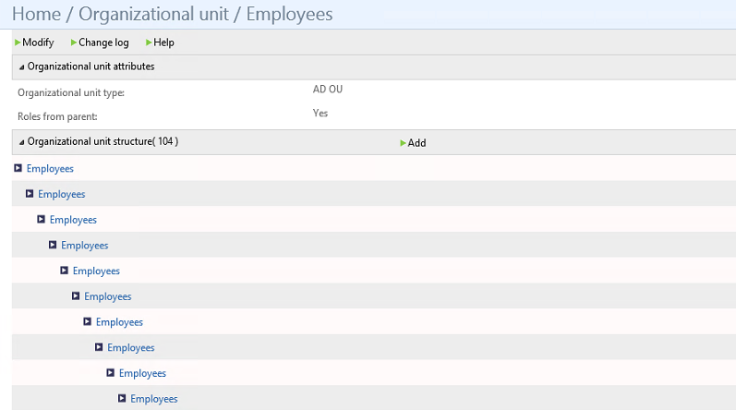
Notes:
Root OU will first be created and all other OUs needs to be children

Slide 15
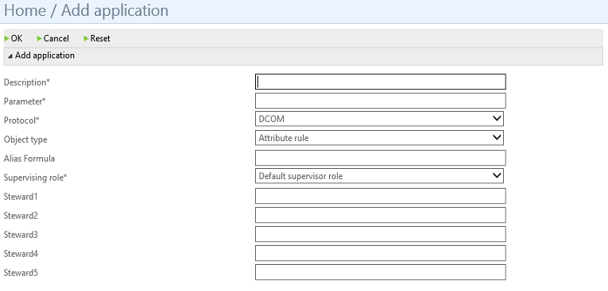
Applications and Permissions
Permissions are your groups
Each permission is part of an application

Slide 16
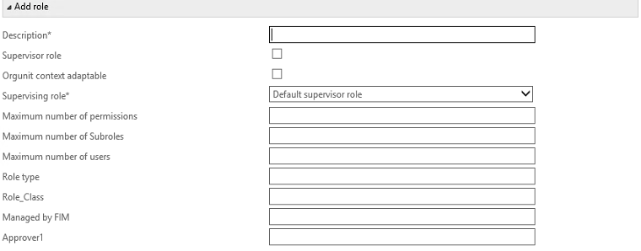
Roles
Collection of access rights and permissions
Few things to consider when configuring the role model
Notes:
Roles are assigned to OU and may be inherited
Roles can be effective and proposed
Roles can be approval roles
Roles can be supervisor roles
ABA roles

Slide 17
Creating Objects in BHOLD Database
Another data store for objects to manage
 | BHOLD Core | BHOLD Model Generator | FIM Sync & BHOLD MA
Organization Unit
Users
Applications
Permissions
Roles

Slide 18
BHOLD Core Component
Pros
Provide a definition for Roles
Add users to multiple groups using one definition
Cons
Limited to adding users to groups
Requires additional provisioning logic
Integration with other applications will require FIM Service/FIM Sync
Maintains objects in another data store

Slide 19
Would I recommend BHOLD Core
Medium size and large deployments that have large number of security groups
Trying to integrate with other system

Slide 20
Suggestion for deploying BHOLD
Not to include it as part of the initial FIM deployment
Use a phased approach: Not to try to integrate and automate every single application
Maintain a role mapping criteria matrix
Which role belongs to which OU?

Slide 21
Organizational Units
Roles |  | Root | Employees | Finance | Information Systems | Marketing | Contractors | Creative Designs
 | Role1 | Assigned/Effective | Inherited/Effective | Inherited/Effective | Inherited/Effective | Inherited/Effective | Inherited/Effective | Inherited/Effective
 | Role2 | N/A | Assigned/Effective | Inherited/Effective | Inherited/Effective | Inherited/Effective | N/A | N/A
 | Role3 | N/A | Assigned/Proposed | Inherited/Proposed | Inherited/Proposed | Inherited/Proposed | N/A | N/A
 | Role4
 | Role5
 | Role6
 | Role7
 | Role8
 | Role9
 | Role10

Slide 22
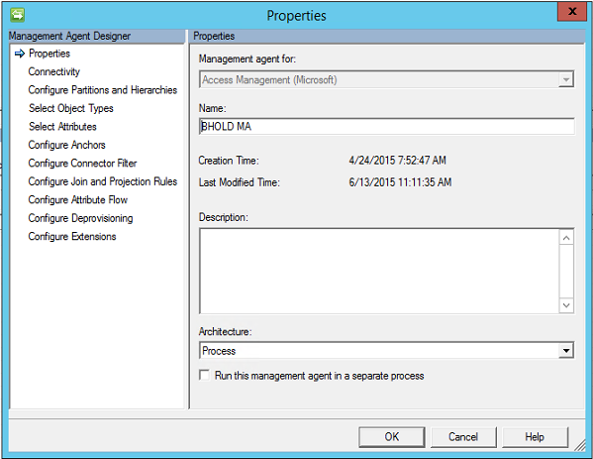
BHOLD Access Management MA
It’s easy to create and configure
Fairly stable in terms of runs
Limited and locked in terms of object types
OU
Permissions
Users
Few challenges with provisioning
bholdFirstName and bholdLastName attributes through exported changes not reimported warning
OUs needs to be reference
Unlike FIM MA, you can write your own code

Slide 23
BHOLD Attestation
It’s one of the missing feature of FIM
It’s not attesting BHOLD roles. It’s attesting that accounts should have those permissions
If access is denied
User will still have the role
Their account for that application will be inactive
Campaigns allow you to attest accounts or permissions
Campaigns have owners and stewards
Can be configured using BHOLD Core
Different ways to define Stewards
OU
Application
User
Upload a file
Notes:
https://technet.microsoft.com/en-us/library/dn155882(v=ws.10).aspx

Slide 24
BHOLD Integration
An extension to the FIM Portal
A rigid User Interface based on SilverLight
No customization
Users can submit requests to activate proposed roles assigned to their OU
Limitation in the Out Of The Box (OOB) approval process
Delegation button doesn’t work (even after applying latest hotfixes)
Notes:
The downsides of the integration components are a lot. Getting a lot of feedback that it’s not user appropriate and users are not adopting it.

Slide 25
BHOLD Reporting
Run reports on BHOLD object only
Get several Build-in reports that you can run and modify
Create your own
Notes:
Report types:
Controls—Reports in this category give you access to basic statistics about your role model as well as top-10 listings of permissions for roles, users, and users by department (organizational unit). Inward Access Control—The report in this category show the supervisor roles for each role in the model. Logging—This category contains reports that list the history of recent activities affecting the role model, including activity specifically affecting organizational units (orgunits), roles, and users. Model—The reports in this category provide a breakdown of information about various object classes in the BHOLD role model, including accounts, applications, users, roles, and permissions. Statistics—The report in this category lets you select a parent orgunit and view the number of users in each child orgunit.

Slide 26
Problems BHOLD Addressing
Attestation: a missing component from FIM, however you need BHOLD core to use it
BHOLD core adds users to groups
Alternatively, dynamic groups can be used
If concerned about the performance of FIM Service when having large number of dynamic groups, then implementing BHOLD core is a good option
Privileged accounts: we will soon have PAM
Self-service: the BHOLD Integration user interface is rigid and not extensible

Slide 27
Open discussion

