Slide 1
Hybrid Reporting in Identity Manager 2016
Sharon Laivand

Slide 2
Identity Manager 2016
RTM is scheduled for June, GA a few weeks after
Modernization
Privileged Access Mgmt.
Hybrid IAM
Updated platform support
Certificate Management updated
Self-service account unlock added
Improved protection of admins
Just In Time (JIT) admin access
Auditing for alerts and reports
Self-service password reset with Azure MFA as a gate
Hybrid reporting

Slide 3
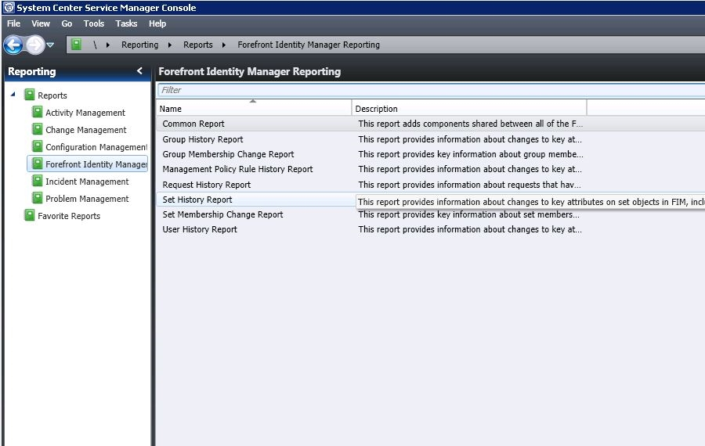
FIM Reporting – Existing Situation
User activity reports delivered via System Center Service Manager
May require separate SQL and System Center Data Warehouse hosts
Custom reports possible but requires System Center Data Warehouse familiarity

Slide 4
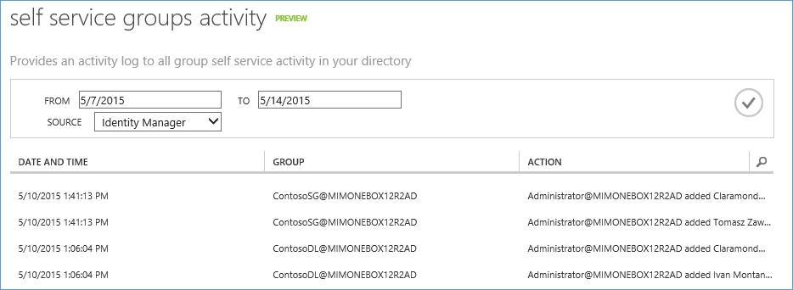
MIM Hybrid Reporting – What is it?

Slide 5
Hybrid Reporting – Why?
Unified Experience
IAM Activity data from Azure AD and Identity manager can be viewed in on place
Eliminate deployment cost
No need to install System Center, SQL, Data-ware house or any other reporting dedicated infrastructure
Your data is yours
Reporting data can be easily exported

Slide 6
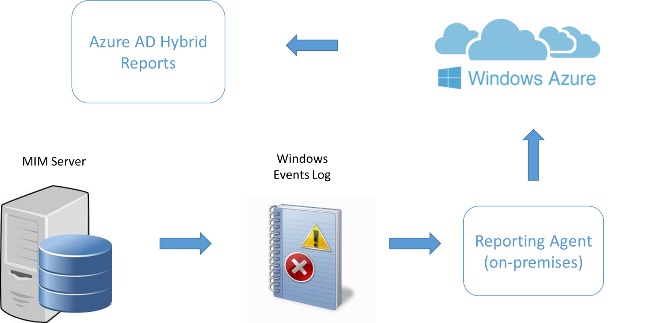
How Does This Work?

Slide 7
How to Evaluate
Download the test lab guide from https://connect.microsoft.com/site433/Downloads
Download the reporting agent from Azure AD configuration tab
Install the reporting agent on Identity Manager server machine
Start viewing Identity Manager reports in Azure AD reporting tab
Currently available: SSPR, SSPR Registration, Group Activity
Send feedback to aadmimfeedback@microsoft.com

Slide 8
Thank You
Sharon Laivand

