Slide 1
The FIM Team User Group
Proudly sponsored by

Slide 2
Housekeeping
I am speaking now – check your audio settings if you can’t hear
Keep your mic muted unless speaking
If you speak, identify yourself first
Make sure you can see the chat window and feel free to use it

Slide 3
The NEWS
Ryan Newington’s Unix MA now on codeplex
http://lithnetsshma.codeplex.com
Peter Stapf’s new FIM blog
http://justIDM.wordpress.com
If you have news for next month drop an email to usergroup@thefimteam.com with the subject “News”.

Slide 4
Impact of FIM Deprecated Features
David Lundell
Rebecca Croft

Slide 5
Today’s agenda
Deprecated Features
Impact
Workaround

Slide 6
Which FIM 2010 Features have been deprecated?

Slide 7
Deprecated Features
Mutil-mastery/equal precedence
ECMA1/XMA
Transaction Properties
FIM CM integration
Out of Process MA
Unselect Allow Nulls (Export)
Do not Recall Attributes
ExchangeUtils 5.5 methods
Lotus Notes MA and SAP R/3 MA
Join on Any object
Programmatic Configuration
Combined Run profiles
http://technet.microsoft.com/en-us/library/jj879229(v=ws.10).aspx

Slide 8
Which FIM 2010 deprecated features have you most worried?

Slide 9
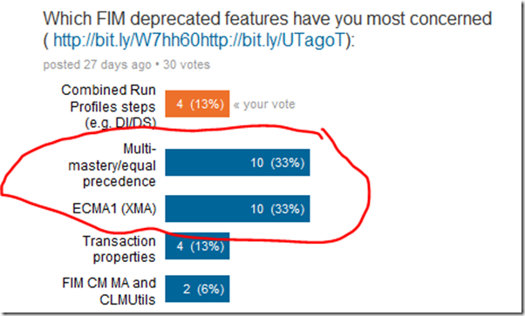
Deprecated Features

Slide 10
Deprecated Features
Almost No impact
Multi-mastery/equal precedence
ECMA1/XMA
Transaction Properties
Major impact
FIM CM integration
Out of Process MA
Minor impact
Unselect Allow Nulls (Export)
Do not Recall Attributes
ExchangeUtils 5.5 methods
Lotus Notes MA and SAP R/3 MA
Join on Any object
Programmatic Configuration
Combined Run profiles
http://technet.microsoft.com/en-us/library/jj879229(v=ws.10).aspx

Slide 11
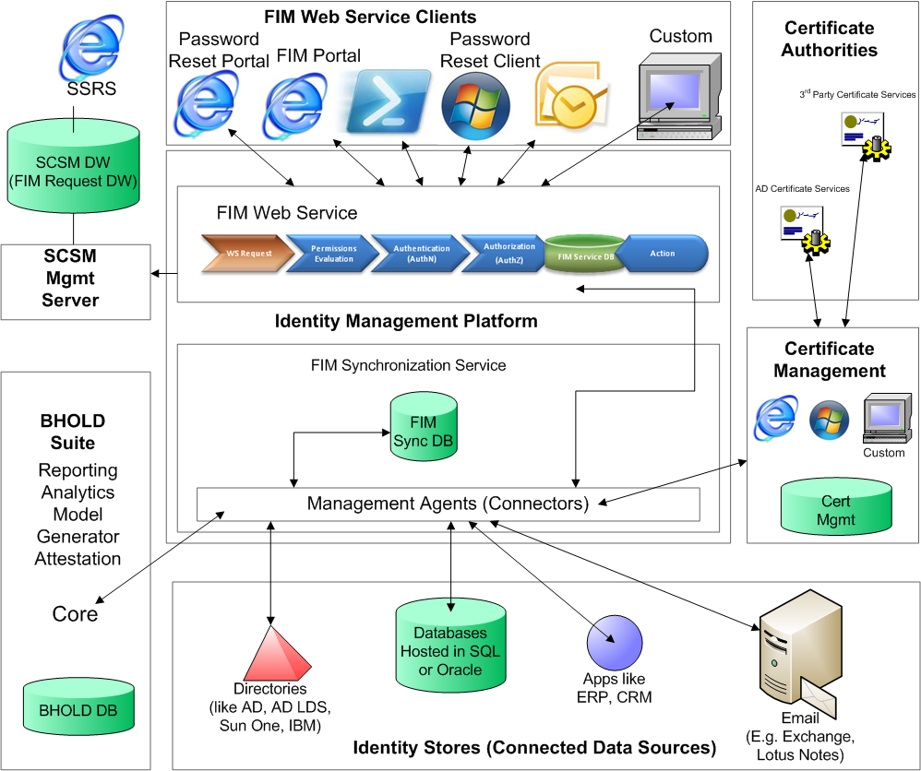

Slide 12
Multi-mastery/equal precedence - Review
As Paul Loonen describes it: As a net effect, when the MV attribute is multi-valued, all values contributed by the different MAs are accumulated in the MV attribute. When the MV attribute is single valued, the value that is last contributed is stored in the MV attribute, or, “the last writer wins”.

Slide 13
Multi-mastery/equal precedence - Impact
Equal precedence will be removed. There is no replacement for this feature. You should configure manual precedence instead.
You can continue to use this feature if your environment has a FIM Service management agent deployed (this management agent does not provide manual precedence) and to avoid export-not-precedent for declarative provisioning.

Slide 14
Multi-mastery/equal precedence - Conclusion
If using FIM Service –
If only using Sync engine –
Keep using it
Ditch it and switch to manual precedence – which means more code

Slide 15
ECMA1/XMA - Impact
Have to switch to ECMA 2.x
Gut says focus on call based
Don’t invest too much in file based

Slide 16
Utils.TransactionProperties
Is a workaround
Hope they give us Reverse Joins
Pass info to other methods
i.e. from ShouldProjectToMV to Provision
So as to not provision the first time through to allow joins to occur
What else did you use it for?
Or from Provision to DeProvision
To help decide to Delete, Explicitly Disconnect or normal disconnect

Slide 17
Combined Run Profiles
What are they
Remember Delta Import/Delta Sync is different?
Delta Import/Delta Sync
Hopefully we get an option process all disconnectors or just those with import changes
Full Import/Delta Sync
Full Import/Full Sync

Slide 19
More questions and discussions
http://social.technet.microsoft.com/Forums/en-US/home?forum=ilm2
David.Lundell@insight.com
Rebecca.Croft@insight.com
Notes:
http://social.technet.microsoft.com/Forums/en-US/home?forum=ilm2
David.Lundell@insight.com
Rebecca.Croft@insight.com

